Slide 1


“A High-Performance Compiler for Modeling and Simulating Molecular Interactions”
Presented by:
L.TULASI (192311250) (Department of CSE)
Institution:
Saveetha Institute of Medical and Technical Sciences
Course:
Compiler Design for Industrial Automation(CSA1429)
Supervisor:
Dr. G.MICHEAL(Department of Computational Data Science)

Slide 2
Introduction
Purpose – A chemistry reaction simulation compiler translates chemical reaction descriptions into machine-executable code. It helps simulate reaction dynamics, predict outcomes, and analyze complex chemical processes.
Components – It includes a parser to read and validate input, an interpreter to convert reactions into computational models, and an optimizer to improve simulation efficiency and accuracy.
Simulation Process – The compiler models reaction kinetics, thermodynamics, and molecular interactions, using methods like Monte Carlo simulations and molecular dynamics to predict rates and outcomes.
Challenges – Handling complex reactions with multiple reactants, side reactions, and varying conditions requires efficient algorithms and accurate chemical data.
Applications – Used in drug development, materials science, and environmental chemistry to model reactions, test conditions, and reduce experimental costs.

Slide 3
Problem Statement
Complexity in Reaction Balancing – Manually balancing chemical equations can be challenging and time-consuming, especially for complex reactions.
Simulation Limitations – Traditional chemistry education relies on static textbooks and limited lab experiments, making it difficult to visualize reaction progress dynamically.
Error-Prone Manual Calculations – Incorrect stoichiometric calculations and reaction predictions can lead to misunderstandings in chemistry learning and research.
Lack of Real-Time Feedback – Many existing tools do not provide instant validation or corrections for chemical equations and reaction conditions.
Difficulty in Predicting Products – Determining reaction products based on reactant properties and conditions requires deep chemical knowledge, which may not be accessible to all learners.
Need for an Automated Chemistry Compiler – There is a demand for a software tool that can interpret, validate, and simulate chemical reactions accurately to enhance learning and research.

Slide 4
Purpose of the Project
Automate Chemical Reaction Processing – Develop a compiler that can interpret, validate, and simulate chemical reactions from user inputs.
Ensure Reaction Accuracy – Implement algorithms to check and balance chemical equations automatically, reducing manual errors.
Provide Real-Time Feedback – Offer instant validation and corrections for chemical equations to assist users in understanding reaction mechanisms.
Enhance Visualization – Generate graphical representations of reaction progress, including molecular structures, energy changes, and reaction pathways.
Support Educational and Research Applications – Serve as a learning tool for students and a research aid for chemists by providing accurate simulations.
Optimize Chemical Simulations – Improve computational efficiency in predicting reaction products, kinetics, and thermodynamics for various chemical processes.

Slide 5
Objectives
Develop a Compiler for Chemical Reactions – Design a system that can parse, analyze, and interpret chemical reaction equations.
Implement Automatic Equation Balancing – Ensure accurate stoichiometric balancing of chemical reactions to maintain mass and charge conservation.
Enable Reaction Simulation – Simulate chemical reactions dynamically, considering factors like temperature, pressure, and catalysts.
Provide Real-Time Error Detection and Correction – Identify and correct errors in reaction equations, ensuring accuracy in chemical computations.5
Integrate Visualization Tools – Display reaction mechanisms, energy changes, and molecular interactions through graphical representations.
Optimize Performance for Educational and Research Use – Ensure efficiency, accuracy, and accessibility for students, educators, and researchers.

Slide 6
Literature Review
Existing Chemical Equation Solvers – Various tools and software, such as ChemDraw and Balancer, assist in balancing chemical equations. However, they lack real-time feedback and in-depth reaction simulations.
Reaction Simulation Techniques – Research in computational chemistry explores methods like molecular dynamics and quantum mechanics to simulate reactions, but these approaches require high computational resources and are not easily accessible for educational use.
Compiler-Based Approaches in Science – Previous studies on domain-specific compilers in biology and physics show that customized programming languages and interpreters can enhance scientific simulations by automating complex calculations.
Challenges in Chemical Reaction Modeling – Literature highlights difficulties in predicting reaction pathways, handling complex organic reactions, and integrating thermodynamic and kinetic data, emphasizing the need for a specialized compiler to address these gaps.

Slide 7
Research Gap
Lack of Compiler-Based Solutions – Existing chemistry tools focus on reaction balancing and simulation separately, but there is no comprehensive compiler that integrates both functionalities in a seamless manner.
Limited Real-Time Feedback – Most available software does not provide immediate validation and error correction for incorrect or unbalanced chemical equations, making learning and experimentation less efficient.
Inadequate Visualization of Reaction Mechanisms – While some tools simulate chemical reactions, they often lack detailed graphical representations of reaction progress, energy changes, and molecular interactions.
Absence of Automated Product Prediction – Current systems rely on predefined reaction databases instead of dynamically predicting reaction products based on reactants and reaction conditions.
High Computational Complexity in Simulations – Advanced chemistry simulation software requires significant computational power, making them inaccessible to students and researchers without high-performance computing resources.

Slide 8
Methodology
Data Collection and Analysis – Gather information on chemical reaction mechanisms, stoichiometry rules, and existing simulation techniques to define the compiler’s processing logic.
Compiler Design and Development – Develop a parsing engine to interpret chemical equations, implement an error-checking module, and integrate an equation balancing algorithm.
Reaction Simulation Implementation – Build a simulation module that considers temperature, pressure, catalysts, and reaction kinetics to predict product formation dynamically.
Visualization and User Interface Development – Create an interactive graphical interface to display reaction progress, molecular structures, and energy changes in real time.
Testing and Validation – Perform extensive testing using known chemical reactions to validate the compiler’s accuracy, efficiency, and usability for educational and research applications.

Slide 9
Technology Stack
Programming Language: Python (for compiler logic, equation parsing, and simulation)
Parsing Library: Lex/ Yacc or PyParsing (for chemical equation interpretation)
Backend Framework: Flask or Django (for web-based implementation and API integration)
Frontend Framework: React.js or Vue.js (for an interactive user interface with real-time visualization)
Database: PostgreSQL or MongoDB (for storing reaction data, user inputs, and simulation results)6. Visualization Tools: Matplotlib, D3.js, or ChemDoodle (for graphical representation of chemical reactions)
Programming and Frameworks – Python for compiler logic and simulation, Flask/Django for backend development, and React.js/Vue.js for the frontend interface.
Data Processing and Visualization – PostgreSQL/MongoDB for storing reaction data, PyParsing for equation parsing, and Matplotlib/D3.js for graphical visualization of reactions.

Slide 10
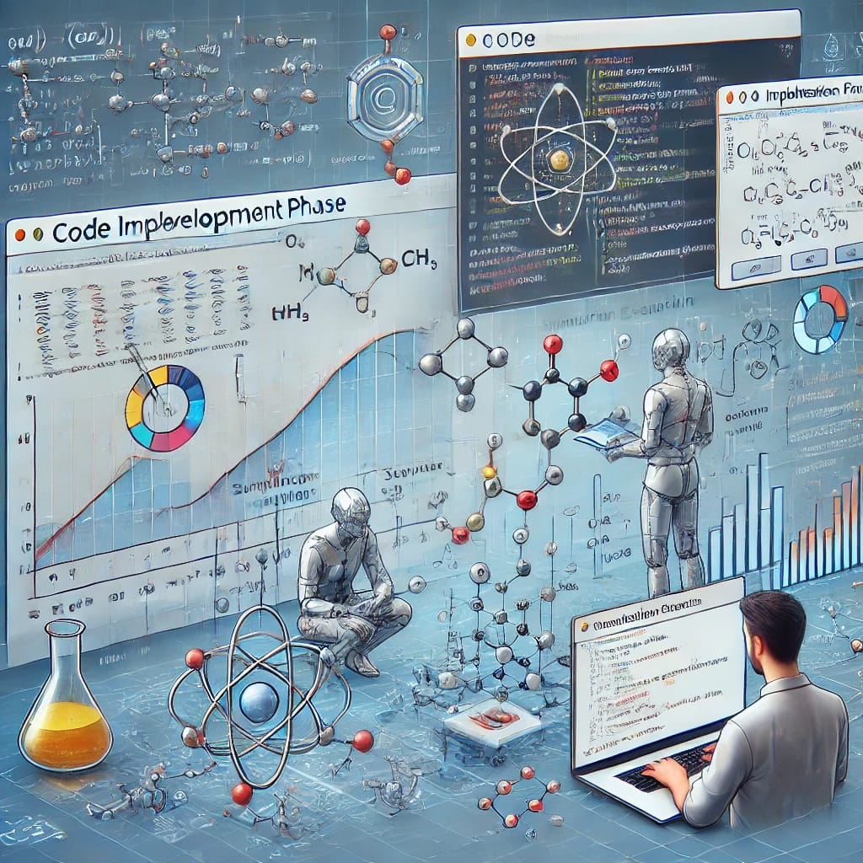
System Architecture
Input and Parsing Layer – The user inputs a chemical reaction, which is processed using a parsing engine (Lex/Yacc or PyParsing) to validate syntax and check for errors.
Processing and Simulation Layer – The compiler balances the equation, predicts reaction products, and simulates reaction kinetics using computational models.
Visualization and Output Layer – The processed reaction is displayed through a user-friendly interface, providing real-time feedback, graphical representations, and detailed reaction insights.

Slide 11
Implementation
Compiler Development – Design and implement the parsing engine to interpret and validate chemical reactions, ensuring correctness in equation balancing.
Simulation Module – Integrate reaction kinetics, thermodynamics, and predictive algorithms to simulate reaction outcomes under different conditions.
User Interface and Visualization – Develop an interactive front-end to display reaction progress, molecular structures, and energy changes in real-time. Implementation:
Development of the Compiler Core – Design and implement the parsing engine to interpret and validate chemical reactions, ensuring correct syntax and equation balancing.
Integration of Machine Learning Models – Implement ML algorithms like Graph Neural Networks (GNN) for reaction prediction and Support Vector Machines (SVM) for reaction classification and rate estimation.
User Interface and Visualization – Develop an interactive front-end to allow users to input chemical equations and visualize reaction progress, molecular structures, and energy changes in real-time.

Slide 12
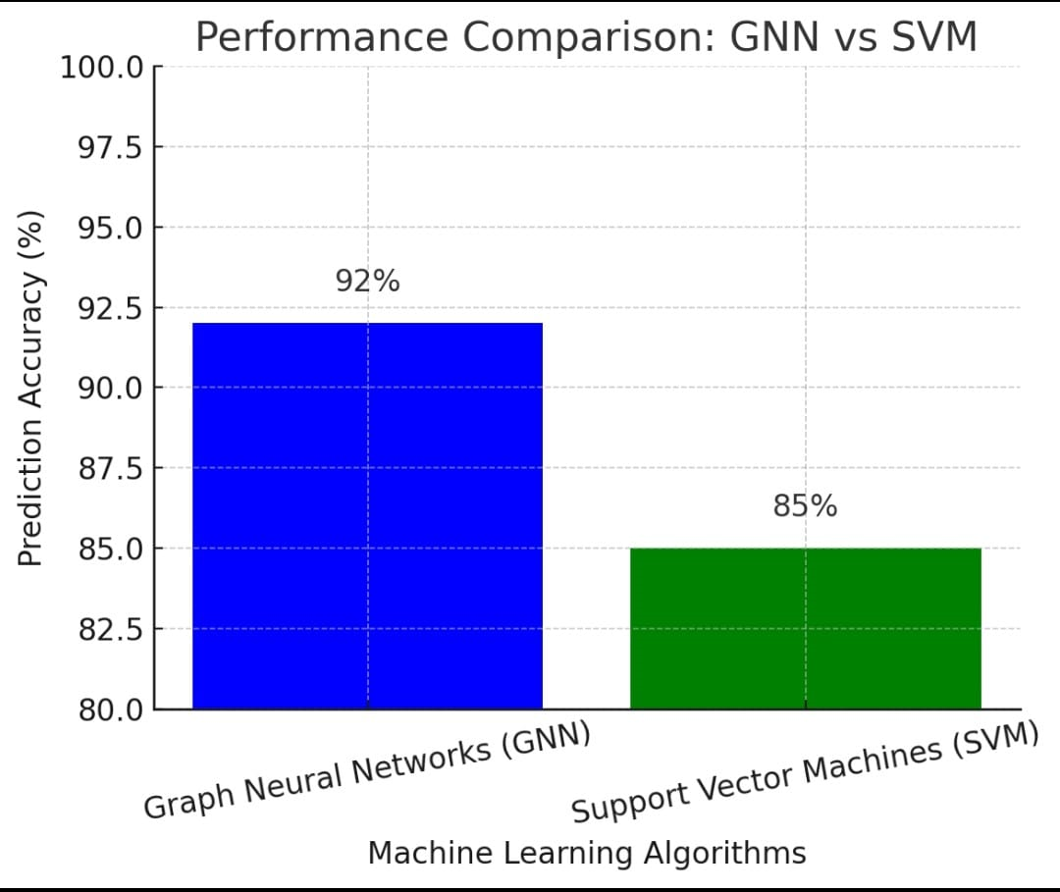
Results & Evaluation
Graph Neural Networks (GNN) are effective in chemistry reaction prediction as they represent molecules as graphs, where atoms are nodes and bonds are edges. They excel in predicting reaction outcomes by learning molecular interactions through Graph Convolutional Networks (GCN).
Support Vector Machines (SVM) are used for reaction classification and rate prediction, leveraging kernel functions to handle complex molecular descriptors. SVMs perform well in high-dimensional datasets but may be less scalable compared to deep learning models like GNNs.

Slide 13
Challenges & Limitations
Complex Organic Reactions – Difficulty in accurately simulating multi-step organic reactions.
Computational Intensity – High processing power required for detailed kinetic and thermodynamic simulations.
Error Handling – Challenges in detecting and correcting incorrect or ambiguous chemical equations.
User Input Variability – Variations in notation and syntax may cause parsing errors.
Limited Database Integration – Dependence on external reaction databases for validation and prediction.
Real-Time Visualization Complexity – Difficulty in rendering dynamic molecular structures and energy changes.
Scalability Issues – Performance bottlenecks when handling large-scale reaction simulations.

Slide 14
Future Scope
Advanced Reaction Prediction – Enhance AI-driven algorithms to predict reaction products and pathways more accurately.
Integration with Quantum Chemistry – Incorporate quantum mechanics-based simulations for precise reaction modeling.
Expansion to Biochemical Reactions – Extend functionality to simulate enzyme-catalyzed and metabolic reactions.
Cloud-Based Simulation – Develop a cloud platform for scalable, high-performance chemical reaction simulations.
Educational and Research Applications – Implement interactive learning modules and collaboration tools for students and researchers.

Slide 15
Conclusion
Transforming Chemical Reaction Simulation – The development of a compiler for chemistry reaction simulation provides an innovative approach to interpreting, balancing, and visualizing chemical reactions. By integrating advanced parsing techniques, simulation models, and real-time feedback, this system enhances the accuracy and efficiency of chemical computations. The interactive visualization and automated validation make it a valuable tool for students, educators, and researchers in understanding complex chemical processes.
Scope for Future Enhancements – While the current system effectively automates reaction analysis and simulation, challenges such as complex organic reactions, computational limitations, and real-time visualization constraints remain. Future improvements, including AI-based product prediction, quantum chemistry integration, and cloud-based simulations, will further enhance its capabilities. This project lays the foundation for a more sophisticated, scalable, and user-friendly chemical simulation platform.

Slide 16
References
Leach, A. R. (2001). Molecular Modelling: Principles and Applications. Pearson. – Discusses computational chemistry techniques for reaction modeling and simulation.
Helgaker, T., Jørgensen, P., & Olsen, J. (2014). Molecular Electronic-Structure Theory. Wiley. – Covers quantum mechanics-based simulations for chemical reactions.
Smith, M. B., & March, J. (2007). March's Advanced Organic Chemistry: Reactions, Mechanisms, and Structure. Wiley. – Provides detailed insights into reaction mechanisms and kinetics.
Cormen, T. H., Leiserson, C. E., Rivest, R. L., & Stein, C. (2009). Introduction to Algorithms (3rd ed.). MIT Press. – Explains algorithmic approaches applicable to chemical equation balancing and compiler design.
Niemeyer, K. E., & Sung, C. J. (2015). "Recent progress and challenges in the development of chemical reaction mechanisms." Progress in Energy and Combustion Science, 49, 1-27. – Discusses computational challenges in chemical reaction.

Slide 17
THANK YOU!

